Slide 1
Hosting instance: 5 docker containers running on
a Digital Ocean droplet. Containers defined in docker config
digby_backend
Flask, gunicorn, celery, MySQLdb
ogrdb_backend
Flask, gunicorn, MariaDB client
Currently there are 2 droplets:
do_prod: production instances of VDJbase, OGRDB, Wordpress
do_beta: 2 test instances of VDJbase containing Corey’s data. Potential also to run OGRDB and
Worpress test servers.
ghcr.io/linuxserver/swag
ngnix, Let’s Encrypt
linuxserver/mariadb MariaDB
wordpress
Wordpress
Digital Ocean 4GB / 80 GB / 2VCPU Ubuntu / Docker weekly backups ~$30 / month per droplet
Documentation for building and managing a server

Slide 2
Outline file system layout
digby_docker
ogrdb_docker
digby_infra
containers
containers
containers
config
config
config
study_data
backup
backup
Directory content
containers – docker configuration, including docker_compose.yml
config – dynamic data, eg configuration, logs, uploaded files study_data – VDJbase’s static data (MySQLdb, reports) backup – backup archive (nightly, weekly, monthly rotations)
Backup approach - file system is snapshot once per week by DO - backups from OGRDB, VDJbase and Wordpress are pulled to my server once a week as an additional precaution
- OGRDB data is deposited in Zenodo once a month

Slide 3
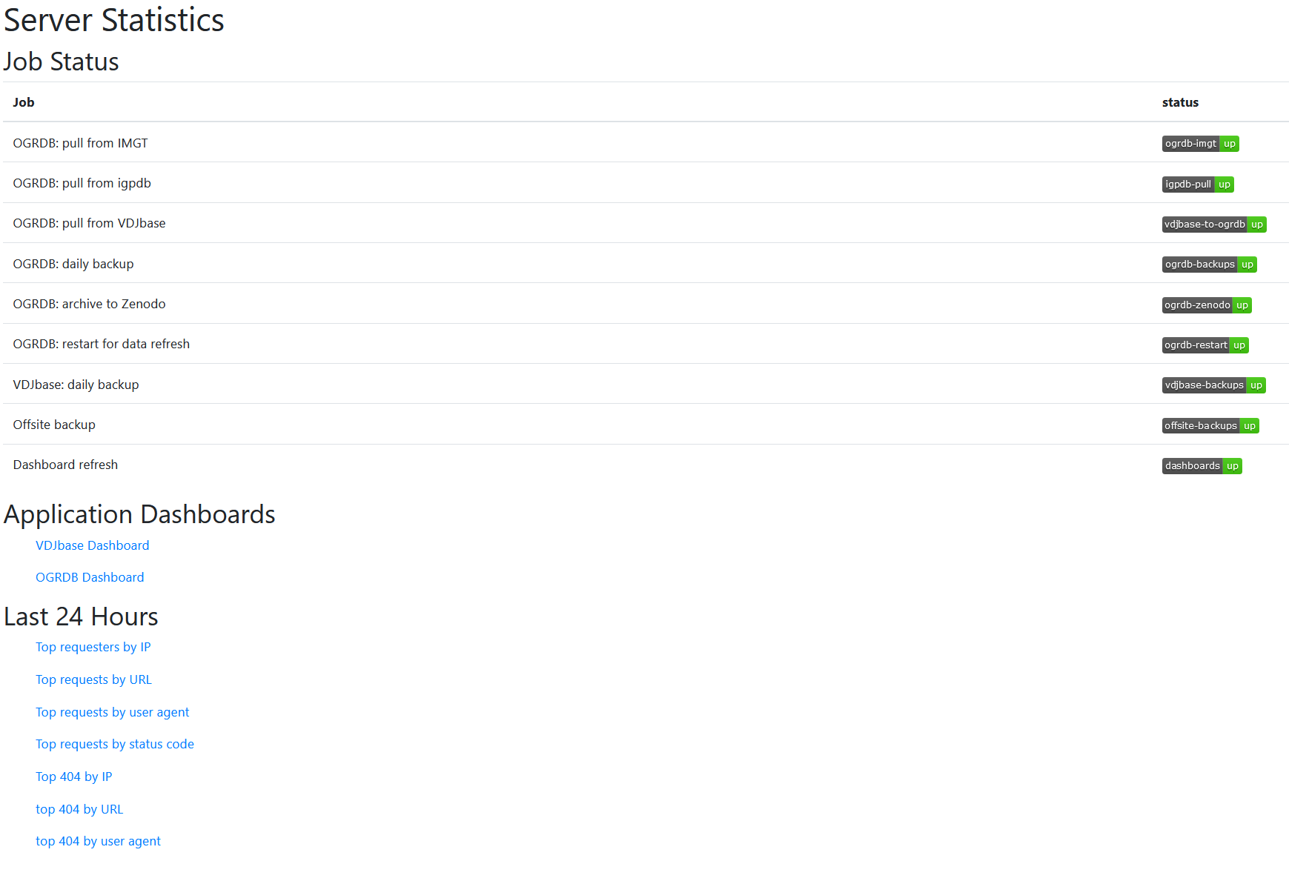
Monitoring - https://vdjbase.org/manage/
From Healthchecks.io: also reports in Slack
Created by goaccess

Slide 4
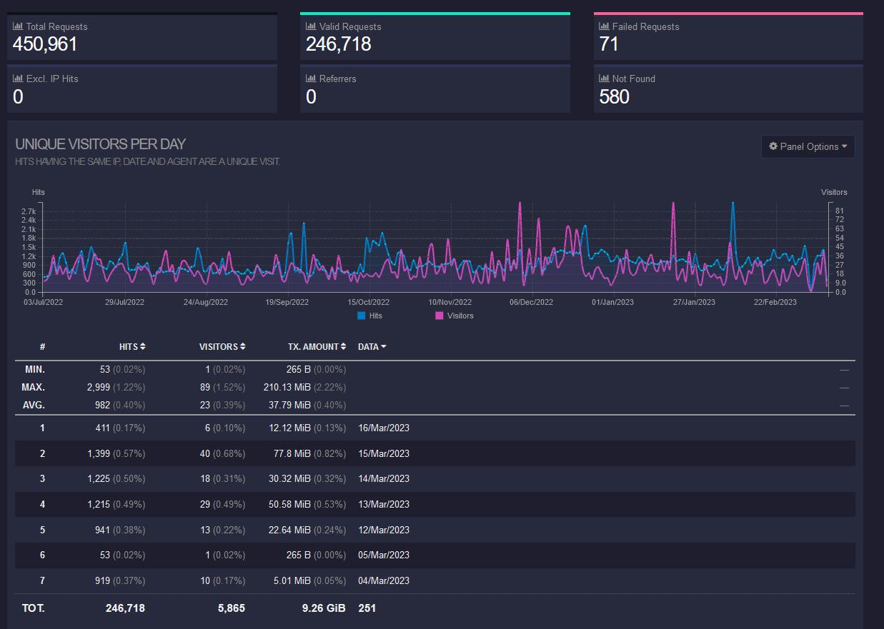
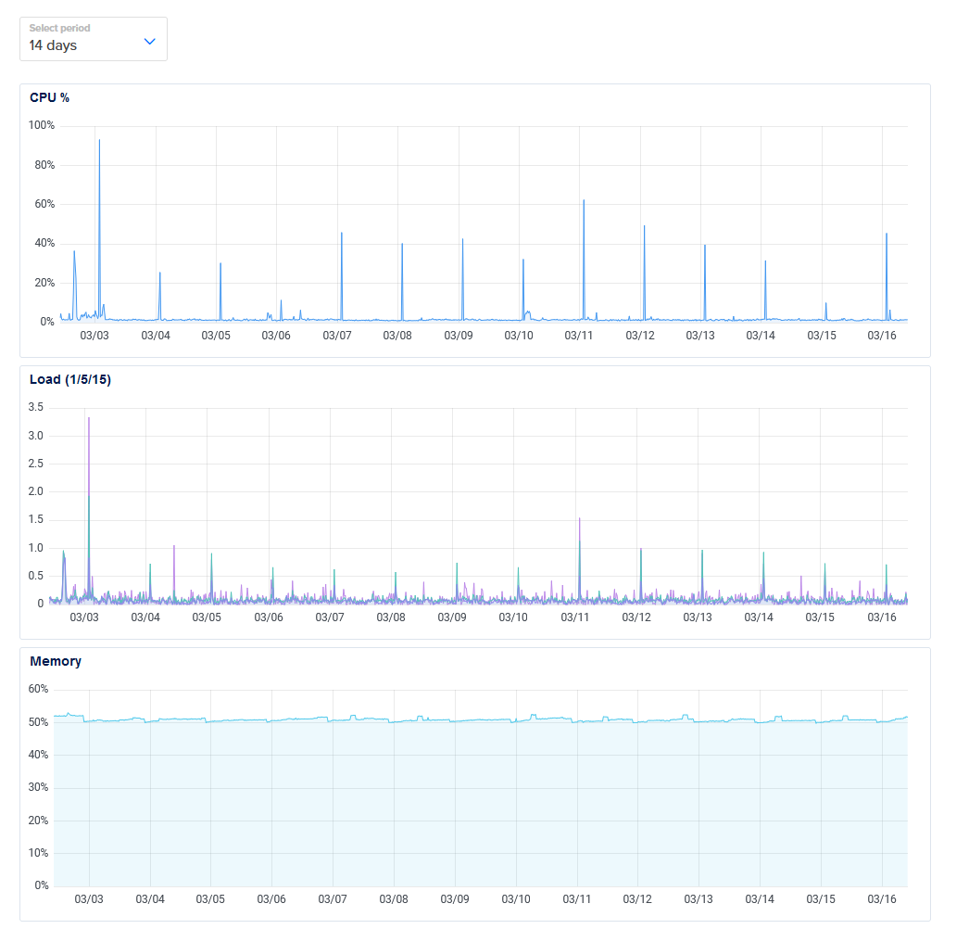
VDJbase unique visitors (from goaccess)
Server load (from Digital Ocean)

